Slide 1

Lists
COMP 2210 – Dr. Hendrix

Slide 2


http://en.wikipedia.org/wiki/List_(computing)
“In computer science, a list or sequence is an abstract data structure that implements an ordered collection of values”
Ordered …
By element value
Self-ordered lists (sorted)
By absolute position (index number)
Indexed lists (sequence)
By relative position (front, rear, after)
Non-indexed lists (“bullet” list)
By time of insertion
Temporal lists (stacks, queues)
By priority
Priority queues

Slide 3
Define:List according to the text and me
Chapter 4 – Unordered List
Aren’t all lists ordered? Isn’t that the point?
“An unordered list is a linear collection of entries whose relative positions with respect to one another is irrelevant.”
Order is independent of element value and is decided by the client.
Auburn
TCU
Oregon
Stanford
Ohio State
Milk
Eggs
Bread
Cheetos
Pizza
Chapter 5 – Ordered List
What’s a key?
“An ordered list is a linear collection of entries in which the entries are arranged in either ascending or descending order of keys.”
Order is completely determined by element value and is not (arbitrarily) decided by the client.
Adams, John, 2, 1797-1801
Adams, John Q., 6, 1825-1829
Arthur, Chester, 21, 1881-1885
Buchanan, James, 15, 1857-1861
Bush, George HW, 41, 1989-1993

Slide 4
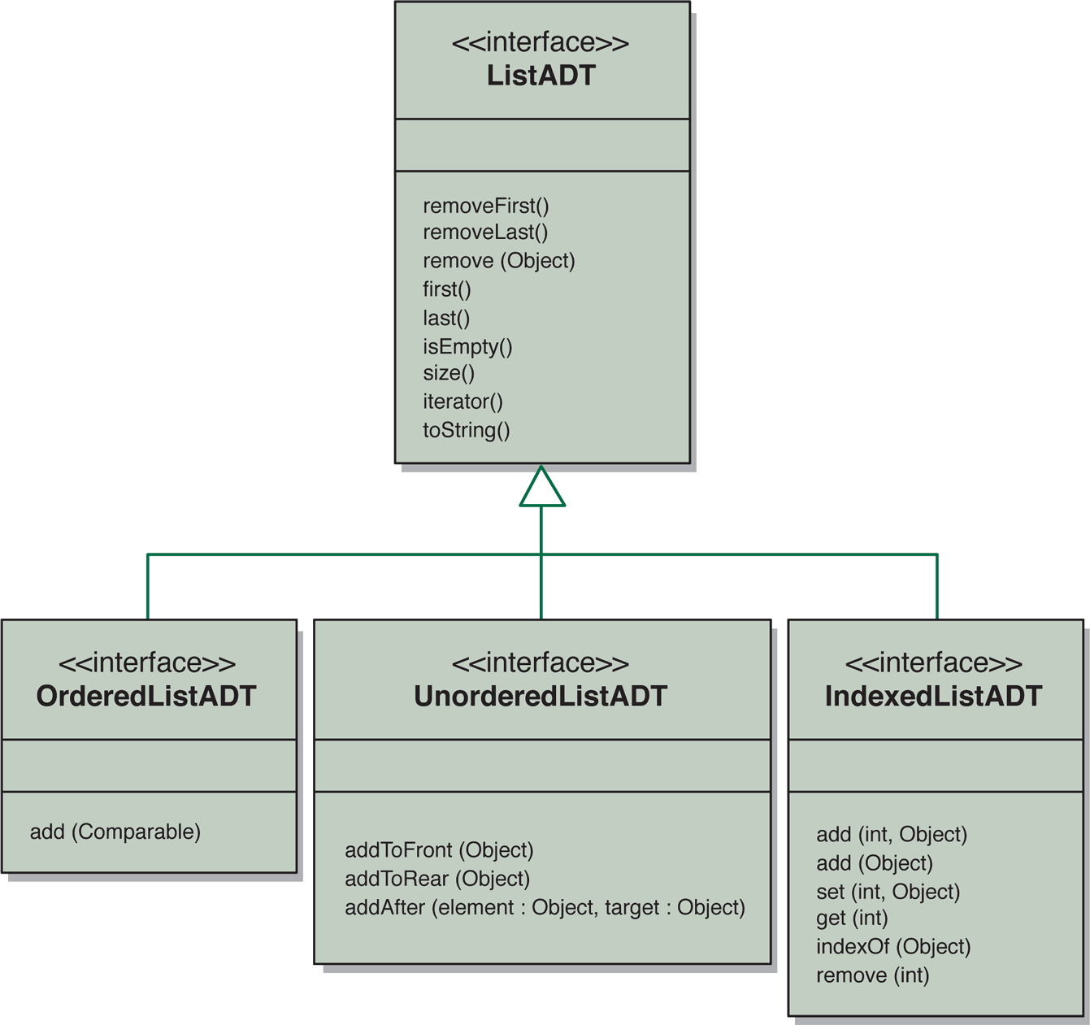
Designing a list collection
From: Lewis and Chase, Java Software Structures
No add method at this level
Different kinds of lists would have to support different kinds of add methods.
Adams, John, 2, 1797-1801
Adams, John Q., 6, 1825-1829
Arthur, Chester, 21, 1881-1885
Buchanan, James, 15, 1857-1861
Bush, George HW, 41, 1989-1993
Milk
Eggs
Bread
Cheetos
Pizza
Auburn
TCU
Oregon
Stanford
Ohio State

Slide 5
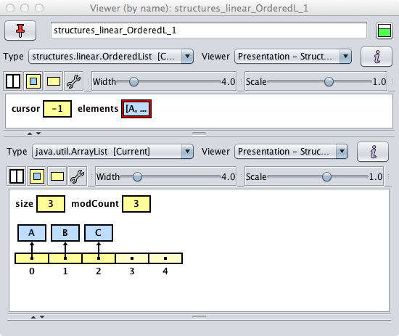
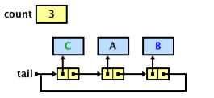
Implementation choices
Array-based
Node-based
Keep elements left-justified (anchored at 0, no gaps)
Keep a size counter (can serve as a rear marker)
Singly-linked
Not circular, no dummy
Keep both a front and rear pointer
Keep a size counter
2210
rear
elements
size
tail
3
A
B
C
•
•
3
0
1
2
3
4
head
A
B
C
•
Use an internal java.util.ArrayList
Keep a “cursor” field to implement iteration.
Singly-linked
Circular, no dummy
Keep only a rear pointer
Keep a size counter
VText

Slide 6
array-based implementation

Slide 7
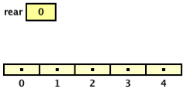
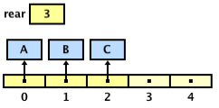
Implementing a list collection: Arrays, add method
public class ArrayIndexedList<T> implements IndexedList<T>
{
private T[] elements;
private int rear;
...
ArrayIndexedList<String> = new ArrayIndexedList<String>(5);
alist.add(“A”);
alist.add(“B”);
alist.add(“C”);
alist.add(1, “D”);
public void add (int index, T element)
{
}

Slide 8
Implementing a list collection: Arrays, add method
public class ArrayIndexedList<T> implements IndexedList<T>
{
private T[] elements;
private int rear;
...
ArrayIndexedList<String> = new ArrayIndexedList<String>(5);
alist.add(“A”);
alist.add(“B”);
alist.add(“C”);
alist.add(1, “D”);
public void add (int index, T element)
{
}
if ((index < 0) || (index > size()))
{
throw new IndexOutOfBoundsException();
}
Validate index

Slide 9
Implementing a list collection: Arrays, add method
public class ArrayIndexedList<T> implements IndexedList<T>
{
private T[] elements;
private int rear;
...
ArrayIndexedList<String> = new ArrayIndexedList<String>(5);
alist.add(“A”);
alist.add(“B”);
alist.add(“C”);
alist.add(1, “D”);
public void add (int index, T element)
{
}
if ((index < 0) || (index > size()))
{
throw new IndexOutOfBoundsException();
}
Validate index
if (isFull())
{
}
expandCapacity();
Check if full

Slide 10
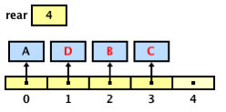
Implementing a list collection: Arrays, add method
public class ArrayIndexedList<T> implements IndexedList<T>
{
private T[] elements;
private int rear;
...
ArrayIndexedList<String> = new ArrayIndexedList<String>(5);
alist.add(“A”);
alist.add(“B”);
alist.add(“C”);
alist.add(1, “D”);
public void add (int index, T element)
{
if ((index < 0) || (index > size()))
{
throw new IndexOutOfBoundsException();
}
if (isFull())
{
expandCapacity();
}
}
Validate index
Check if full
shiftRight(index);
elements[index] = element;
rear++;
Insert new
element

Slide 11
Arrays, add method – time complexity
public class ArrayIndexedList<T> implements IndexedList<T>
{
private T[] elements;
private int rear;
...
public void add (int index, T element)
{
if ((index < 0) || (index > size()))
{
throw new IndexOutOfBoundsException();
}
if (isFull())
{
expandCapacity();
}
}
The add method is O(N).
Validate index
O(1)
Check if full
O(N)
We can amortize this
shiftRight(index);
elements[index] = element;
rear++;
Insert new
element
O(N)
Two important points:
(1)
expandCapacity() should not be called often.
(2)
The physical insertion is O(1).
Use “repeated doubling.”
Having to shift elements is O(N).
Consider a reduceCapacity() for remove.
This is unavoidable with order.

Slide 12
node-based implementation

Slide 13

Implementing a list collection: Nodes, add method
public class LinkedIndexedList<T> implements IndexedList<T>
{
private Node<T> head;
private Node<T> tail;
private int size;
...
public void add (int index, T element)
Empty
Not empty

Slide 14
Implementing a list collection: Nodes, add method
Four cases to consider for add
Empty
Non-Empty, index == 0
Non-Empty, index == size()
Non-Empty, index in the middle

Slide 15
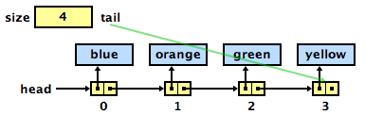
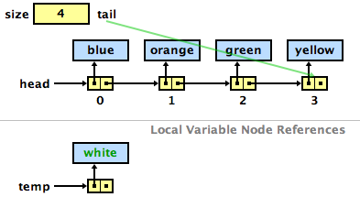
Implementing a list collection: Nodes, add method
Validate index, allocate memory
public void add (int index, T element)
{
if ((index < 0) || (index > size))
{
throw new IndexOutOfBoundsException();
}
LinearNode<T> temp = new LinearNode<T>(element);
if (isEmpty())
{
head = temp;
tail = temp;
}
else if (index == 0)
{
temp.setNext(head);
head = temp;
}
else if (index == size)
{
tail.setNext(temp);
tail = temp;
}
else
{
LinearNode<T> p = head;
for (int i = 0; i < index-1; i++)
{
p = p.getNext();
}
temp.setNext(p.getNext());
p.setNext(temp);
}
size++;
}
index < 0 || index > 4
list.add(-1, "red");
-----
Exception in evaluation thread java.lang.IndexOutOfBoundsException
list.add(10, "red");
-----
Exception in evaluation thread java.lang.IndexOutOfBoundsException
index >= 0 && index <= 4
list.add(2, “white");

Slide 16
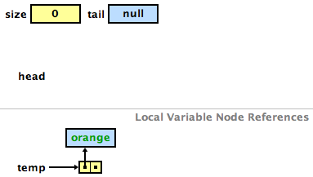
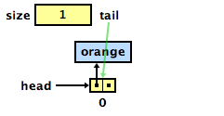
Implementing a list collection: Nodes, add method
Add to an empty list
public void add (int index, T element)
{
if ((index < 0) || (index > size))
{
throw new IndexOutOfBoundsException();
}
Node<T> temp = new Node<T>(element);
if (isEmpty())
{
head = temp;
tail = temp;
}
else if (index == 0)
{
temp.setNext(head);
head = temp;
}
else if (index == size)
{
tail.setNext(temp);
tail = temp;
}
else
{
Node<T> p = head;
for (int i = 0; i < index-1; i++)
{
p = p.getNext();
}
temp.setNext(p.getNext());
p.setNext(temp);
}
size++;
}
list.add(0, “orange");

Slide 17
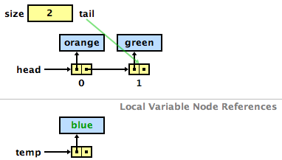
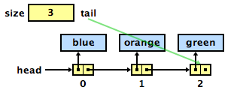
Implementing a list collection: Nodes, add method
Add to a non-empty list at index 0
public void add (int index, T element)
{
if ((index < 0) || (index > size))
{
throw new IndexOutOfBoundsException();
}
Node<T> temp = new Node<T>(element);
if (isEmpty())
{
head = temp;
tail = temp;
}
else if (index == 0)
{
temp.setNext(head);
head = temp;
}
else if (index == size)
{
tail.setNext(temp);
tail = temp;
}
else
{
Node<T> p = head;
for (int i = 0; i < index-1; i++)
{
p = p.getNext();
}
temp.setNext(p.getNext());
p.setNext(temp);
}
size++;
}
list.add(0, “blue");

Slide 18
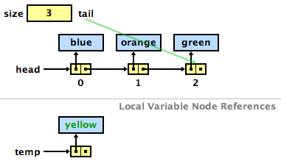
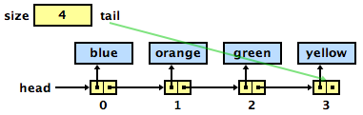
Implementing a list collection: Nodes, add method
Add to a non-empty list at index size()
public void add (int index, T element)
{
if ((index < 0) || (index > size))
{
throw new IndexOutOfBoundsException();
}
Node<T> temp = new Node<T>(element);
if (isEmpty())
{
head = temp;
tail = temp;
}
else if (index == 0)
{
temp.setNext(head);
head = temp;
}
else if (index == size)
{
tail.setNext(temp);
tail = temp;
}
else
{
Node<T> p = head;
for (int i = 0; i < index-1; i++)
{
p = p.getNext();
}
temp.setNext(p.getNext());
p.setNext(temp);
}
size++;
}
list.add(list.size(), “yellow");

Slide 19
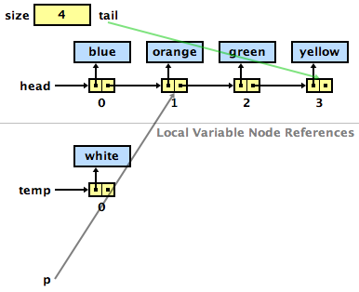
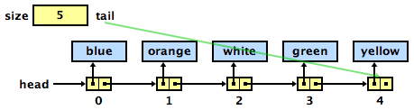
Implementing a list collection: Nodes, add method
Add to a non-empty list in the middle
public void add (int index, T element)
{
if ((index < 0) || (index > size))
{
throw new IndexOutOfBoundsException();
}
Node<T> temp = new Node<T>(element);
if (isEmpty())
{
head = temp;
tail = temp;
}
else if (index == 0)
{
temp.setNext(head);
head = temp;
}
else if (index == size)
{
tail.setNext(temp);
tail = temp;
}
else
{
Node<T> p = head;
for (int i = 0; i < index-1; i++)
{
p = p.getNext();
}
temp.setNext(p.getNext());
p.setNext(temp);
}
size++;
}
list.add(2, “white");
Slightly different traversal pattern

Slide 20
Nodes, add method – time complexity
public void add (int index, T element)
{
if ((index < 0) || (index > size))
{
throw new IndexOutOfBoundsException();
}
Node<T> temp = new Node<T>(element);
if (isEmpty())
{
head = temp;
tail = temp;
}
else if (index == 0)
{
temp.setNext(head);
head = temp;
}
else if (index == size)
{
tail.setNext(temp);
tail = temp;
}
else
{
Node<T> p = head;
for (int i = 0; i < index-1; i++)
{
p = p.getNext();
}
temp.setNext(p.getNext());
p.setNext(temp);
}
size++;
}
The add method is O(N).
O(1)
Important point:
The physical insertion is O(1).
O(1)
Finding where the new element goes is O(N).
O(1)
O(1)
O(N)

Slide 21
performance comparison

Slide 22
Performance analysis
 | Indexed List |  | Non-indexed List |  | Self-ordered List
method | Array | Nodes | Array | Nodes | Array | Nodes
remove(element) | O(N) | O(N) | O(N) | O(N) | O(N) | O(N)
addAfter(element, target) | • | • | O(N) | O(N) | • | •
add(element) | O(1) | O(1) | • | • | O(N) | O(N)
add(index, element) | O(N) | O(N) | • | • | • | •
get(index) | O(1) | O(N) | • | • | • | •
indexOf(element) | O(N) | O(N) | • | • | • | •
Tell me why …
Can we do better…
If we could use binary search on a node-based structure, then add() and remove() would be O(log N) – a huge improvement!
Stay tuned … this is exactly where we’re headed.

